Slide 1





Motaleb Hossain
ID: 2125051071
Md Ebrahim
ID: 2125051062
Haemaet Uddin
ID: 2125051068
Reduanul Karim Abid
ID: 2125051058

Slide 2

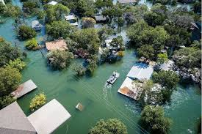
Impact of flood in Bangladesh
4.5 Million People in Bangladesh don’t know about flood

Slide 3
Flood Prediction and Risk Mitigation
Real-Time Data Integration
Risk Visualization
Scalable Framework

Slide 4
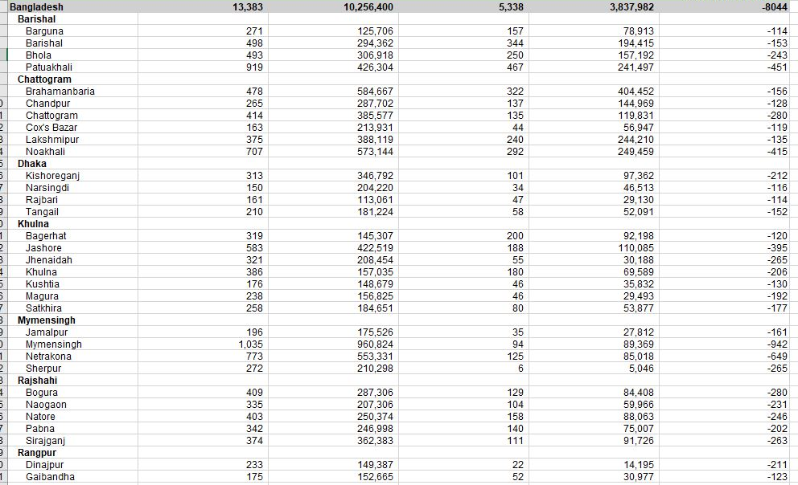
Flood Affected Area Data Set

Slide 5
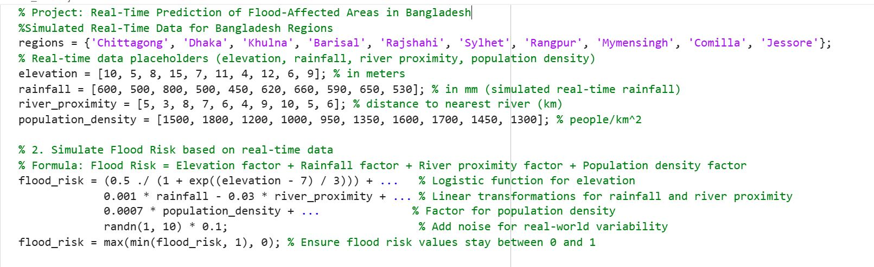

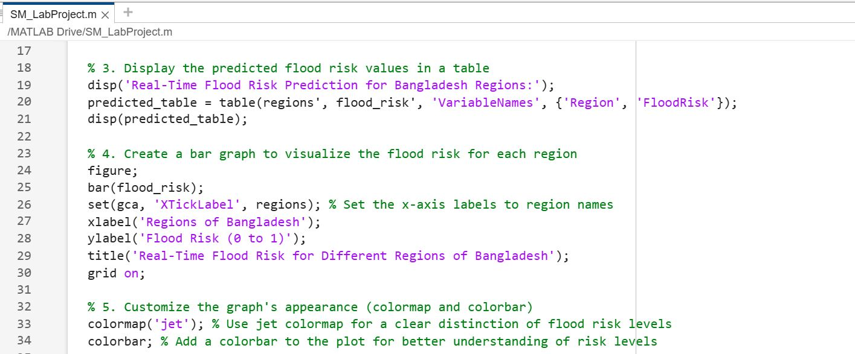

Slide 6
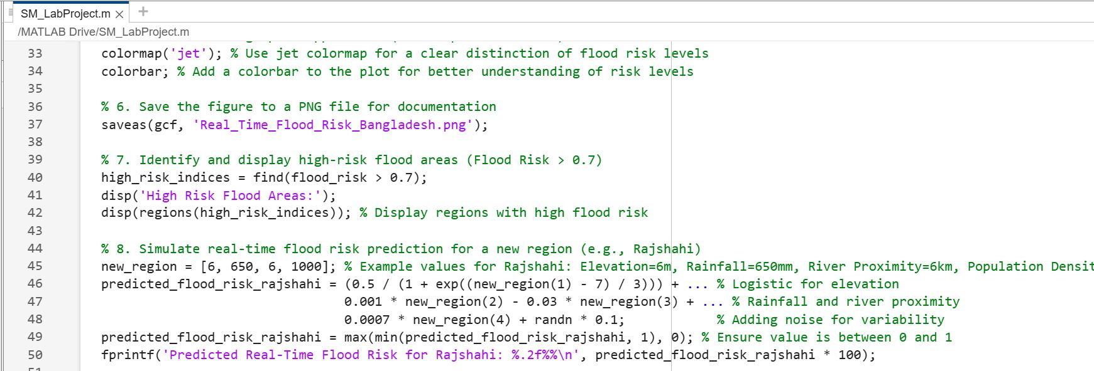
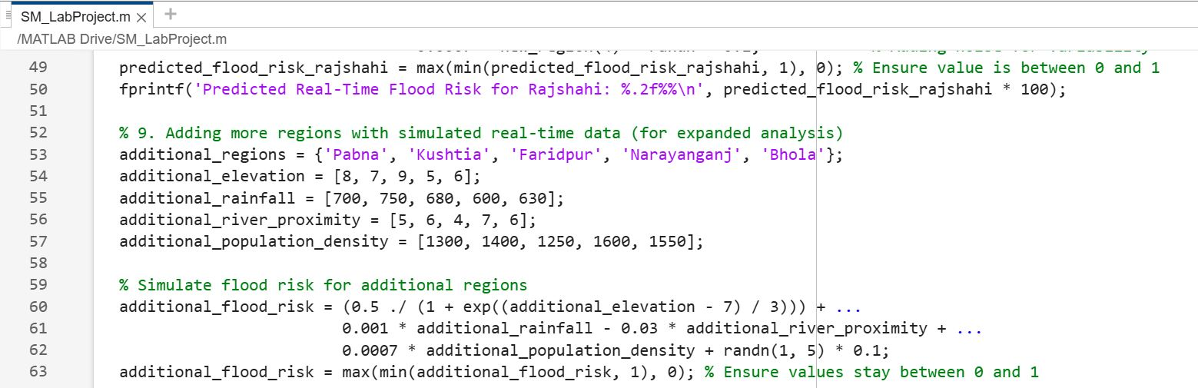

Slide 7
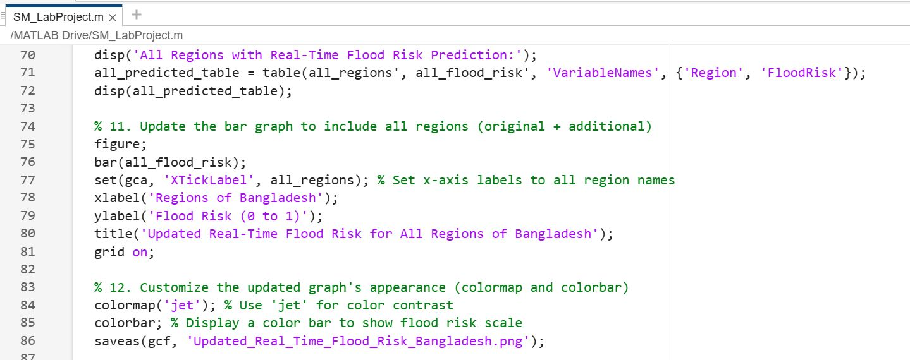
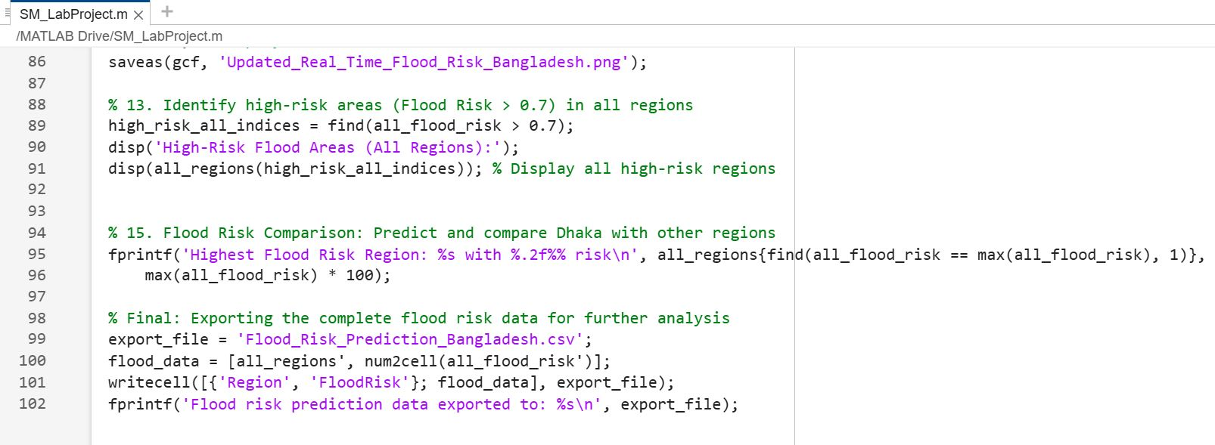

Slide 8
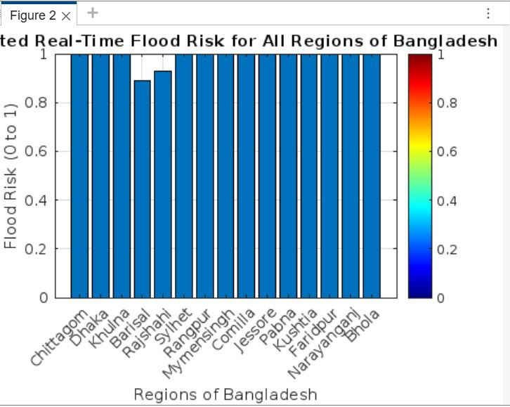

Slide 9
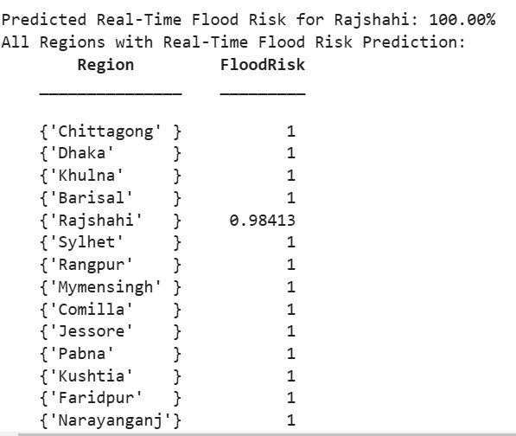
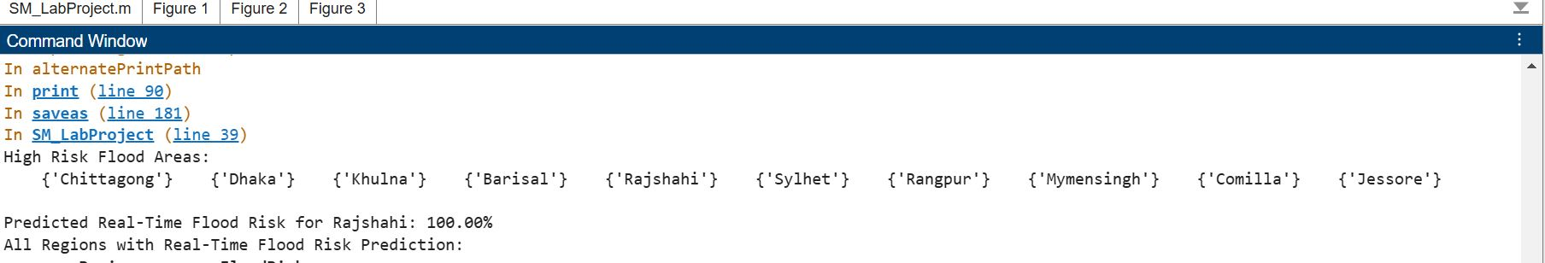

Slide 10
This project empowers
Government agencies
Disaster management teams
local communities

Slide 11
Thank you so much

